Slide 1
Keys to Successful Mentoring (Successful Archival Research)
Notes:
Thank you S. P. and Ed for your kind remarks. Someone once asked me, how do you produce such good students like S.P and Ed. My response—It’s easy. Just get out of their way and try not to mess them up too much. I guess I did a pretty good job of that.
I have to be honest with everyone here today. My mentoring treatment effect had little to do with the outstanding research careers of S. P. and Ed. Their innate abilities trump everything else.
I am both honored and humbled to be receiving this recognition today. As I look out over this audience, I see many others who are equally deserving of this recognition. So why me? My conclusion is that I have everyone else beat on age. To give you some idea of how long I’ve been around, when I started in this great profession, we submitted our jobs on decks of punched card s, tapes were actually mounted and spun, and if we needed more than 256K to run the job, the job had to be run over night. We’ve come a long way in the last 40 years!
When Brian notified me that I would be receiving this award, he asked that I take a few minutes to share with you some keys to successful mentoring. So I’ve come up with a top 10 list. So here goes.

Slide 2
Environmental Factors
Surround yourself with committed research colleagues.
Have weekly research workshops with speakers that use different paradigms and different methodologies.
Provide pre-workshop brownbag sessions with doctoral students to help focus and refine questions to ask at the workshop.
Notes:
Successful mentoring is not a one man show-it’s a team effort.
I’ve been blessed to have many excellent colleagues to work with over the years, both inside and outside the department and the success of the Iowa PhD program is in large part do to them.
Having weekly workshops that feature papers with different paradigms and methodologies preceded by pre-workshop brown-bag sessions to go over the papers helps to develop students’ awareness of a broad range of research and helps them to be a better colleagues. I always leave these pre-workshop brown bag sessions and workshops having learned something, and I’m sure our doctoral students feel the same way.

Slide 3
Doctoral Seminars
Teach a doctoral seminar as often as possible.
Change at least half of the readings every time you teach a seminar.
Brainstorm possible research ideas during each class session.
Invite students to collaborate on research projects.
Notes:
Teaching a doctoral seminar on a regular basis and changing half the reading list helps to keep you abreast of the literature.
Brainstorming on possible research ideas has often led to co-authored work with doctoral students which, in many cases, has helped launch successful research careers.

Slide 4
Selecting and Motivating Topics
Identify questions that are of broad appeal—citations are the name of the game.
First three paragraphs of a paper are critical (Bill Kinney)
Clearly state what the question is that you are addressing.
Explain why this question is important and to whom.
How is the paper going to contribute to the extant literature.
Provide solid theoretical underpinnings for your research (economic reasoning or formal model).

Slide 5
Analyze Validity Threats Using Predictive Validity (Libby) Boxes
Independent Dependent
1
Conceptual
Theoretical
X
Theoretical
Y
Construct Validity
2
2
3
Operational
Operational
X
Operational
Y
Statistical Conclusion Validity
4
Internal Validity
Control
Other potentially influential variables
Vs and Zs (omitted correlated variables)

Slide 6
Design Issues
Be sure the empirical proxies agree with the theoretical constructs (construct validity). If they don’t, you may be introducing a confounding V or Z influence into your analysis, which can bias or add noise to your tests.
Always watch for possible V (factors that affect both X and Y) or Z influences (concurrent events) when testing the effects of X on Y.
Understand the analytics behind Type I and Type II errors.
(currently preparing a paper on this for JFR)
Notes:
There are two types of errors, as researchers, that we should always try to minimize.
Type I—falsely rejecting a true null.
Type II—failing to reject a false null.
I’ve come to believe that many who do empirical work in the earnings management area (and that includes myself) do not fully understand the analytics behind Type I errors. As a result, I don’t believe we have a good sense of how frequentlyType I errors are committed in the literature.
On this, I concur with a recent concern raised by Ray Ball (2013 Accounting Horizons):
“There appears to be a widely held belief among accounting researchers that “earnings management” is rife. A powerful cocktail of authors’ strong priors, strong ethical and moral views, limited knowledge of the determinants of accruals in the absence of manipulation, and willingness to ignore correlated omitted variables in order to report a result, seems to have fostered a research culture that tolerates grossly inadequate research designs and publishes blatantly false positives.” (Page 850, emphasis added.)

Slide 7
Writing Tips
Write clearly—
Avoid the use of vague ill-defined terms.
Avoid excessively lengthy sentences.
Avoid excessive jargon.
Use pictures to tell your story. A picture is worth a thousand words/Tables of numbers (and will stick in readers’ minds a lot longer).
What famous paper do the following results come from?

Slide 8
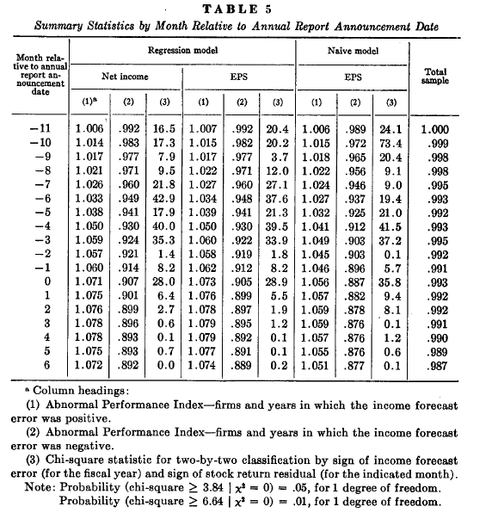

Slide 9
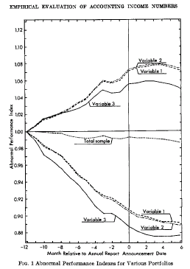
Ball & Brown (1968 JAR)

Slide 10
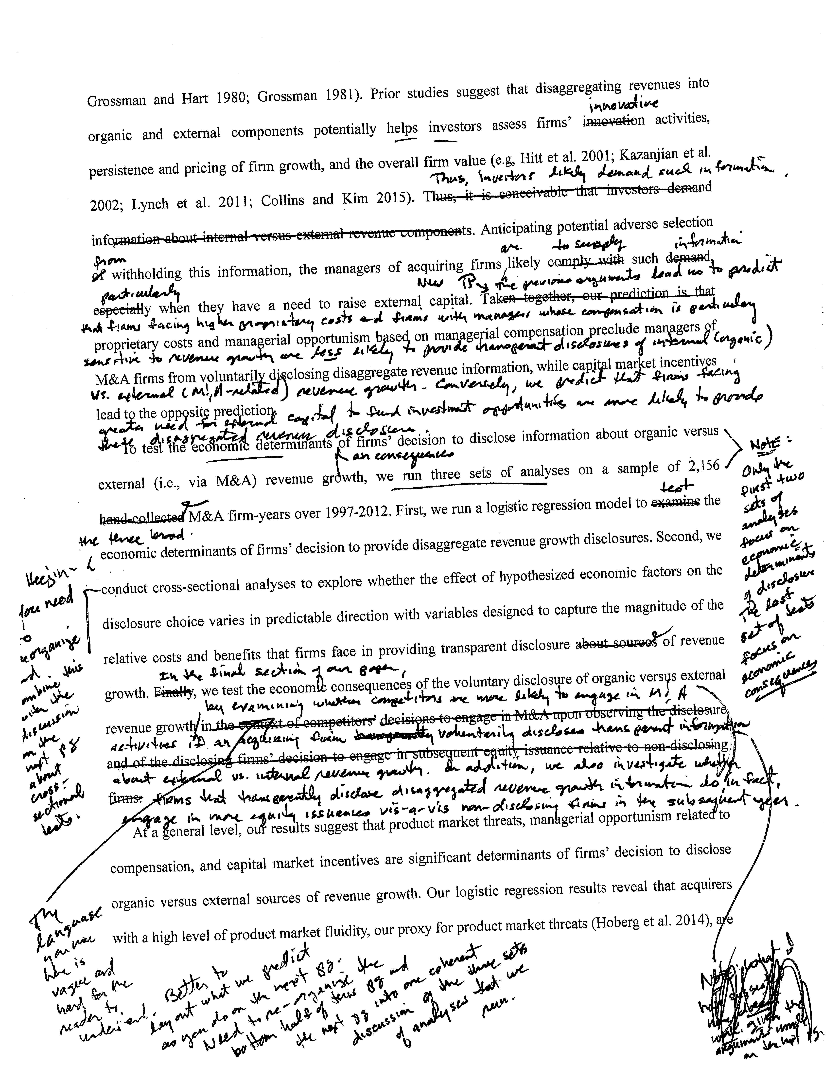
Offer Detailed Writing Suggestions
Notes:
One of the first papers I ever published was a JAR paper for which Nick Dopuch served as editor.
After going through 2 or 3 rounds of review, the paper was finally accepted. But with the acceptance letter, Nick sent me his marked-up copy of the paper. And it looked much like the page above. After following his editorial suggestions, it was amazing how much clearer the paper became.
I have vowed ever since to offer similar detailed writing suggestions on early drafts of student papers whenever needed.
But my students have gotten wise to me—they now use narrow margins!!!

Slide 11
Distinguished List of Mentees
Notes:
Finally, I want to recognize the students for whom I have had the privilege of serving as dissertation chair. As you scan down through this list of names, you’ll see many who have had very productive and distinguished research careers. These people have added immensely to the financial archival research literature.
I ran a Granger reverse causality test and found that these people have had a bigger impact on my research productivity than I have had on theirs. So these folks deserve this award as much or more than I do!
If you are in the audience, please stand to be recognized.
Finally, I would ask all Iowa PhD alums to stick around for group photo afterward.
Thank You

Slide 12
Thank You

